Slide 1
Echinococcus granulosus
The dog tapeworm
Dr. Bindhusaran M.D. (Hom.)
Assistant Professor
Dept. of Pathology & Microbiology

Slide 2
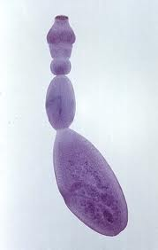
Habitat and morphology
Intermediate host: Man - harbors larval stage
D.H: dog and other canine animals
Morphology
Adult worm: 3 -6 mm length
Head : 4 suckers, rostellum bears hooks
Neck: short and thick
Strobila: 3 segments

Slide 3
Egg
Ovoid and resembles eggs of other taenia
Consits of hexacanth embryo with hooks
Infective to cattle and man
Larval form:
Found in the hydatid cyst
Bears scolex which posses suckers and hooks

Slide 4
Life Cycle
The worm passes its life cycle in two hosts.
1. Definitive Hosts: Dog, wolf, fox and jackal. The adult worm lives in the small intestine of these animals.The dog is the optimum definitive host.
2. Intermediate Hosts. Sheep, pig, cattle, horse, goat and man.
The larval stage is passed in these animals and man giving rise to hydatid cyst.
The sheep appears to be the optimum intermediate host.

Slide 5
Life cycle
The eggs are discharged with the faeces of the definitive hosts (dog and allied animals).
These are swallowed by the intermediate hosts, sheep and other domestic animals while grazing in the field, and also by man (particularly children) due to intimate handling of infected dogs.
In the duodenum, the hexacanth embryos are hatched out. And bore their way through the intestinal wall and enter the radicles of the portal vein.

Slide 6
Life cycle
The embryos are carried to the liver to be arrested in the sinusoidal capillaries (the liver acts as the first filter).
Some of the embryos may pass through the hepatic capillaries, enter the pulmonary circulation and filter out in the lungs (lungs act as the second filter).
A few of the embryos may pass the pulmonary capillaries, enter the general blood stream and lodge in the various organs.
Practically, all the organs of the domestic animals may be invaded but they are chiefly found in the liver and lungs. Wherever the embryo settles, it forms a hydatid cyst, the young larva being transformed into a hollow bladder

Slide 7
Life cycle
(hydatis, drop of water).
From the inner side of the cyst, brood capsules with a number of scolices are developed.
A hydatid cyst developing from a single egg (oncosphere) may contain thousands of scolices.
A fully developed scolex is an end-product and its presence inside the hydatid cyst is a sign of “a complete biological development”.
These fertile hydatids, when ingested by the dog, are capable of growing into adult worms in about 6 to 7 weeks’ time in the intestine. Thus, the cycle is repeated.

Slide 8
Life cycle
As the dogs have no access to the hydatid cyst developed in the viscera of man, the life cycle of the parasite comes to a dead-end. The natural cycle is thus maintained by dog and sheep.
Life span of the adult worm in the canine host is short (about 6 months).

Slide 9
Pathogenicity.
The adult worms of E. granulosus in dogs do not cause much inconvenience.
The larval worm of E. granulosus in man causes unilocular hydatid disease.

Slide 10
Pathogenesity
Infecting Agent Eggs, in dog's faeces.
Portal of Entry- Alimentary tract.
Sites of localization Viscera (liver, lungs and other organs).
EVOLUTION OF HYDATID CYST
Cyst wall cosists of 2 layers:
(1) Outer Cuticular Layer (Ectocyst). I t is a laminated hyaline membrane having a thickness up to
1 mm. To the naked eye, the ectocyst has the appearance of white of a hard_boiled egg . it is elastic
(2) Inner or Germinal Layer (Endocyst) : It is cellular and consists of a number of nuclei embedded in a protoplasmic mass
It is very thin and measureas about 22 to 25 micrometre in thickness. It is the vital layer of the cyst and gives rise to brood capsules with scolices (b ) secretets the specific hydatid fluid, and (c) forms the outer layer.

Slide 11
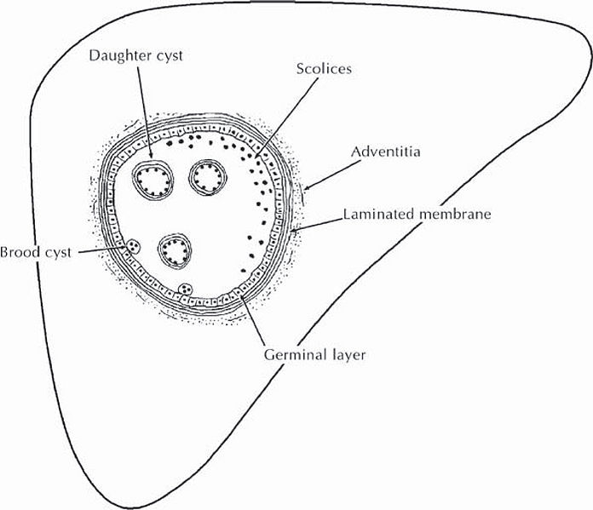
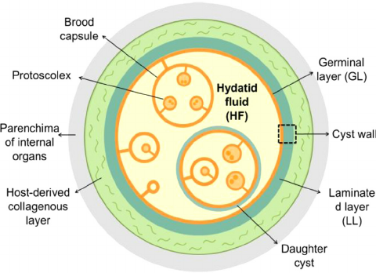
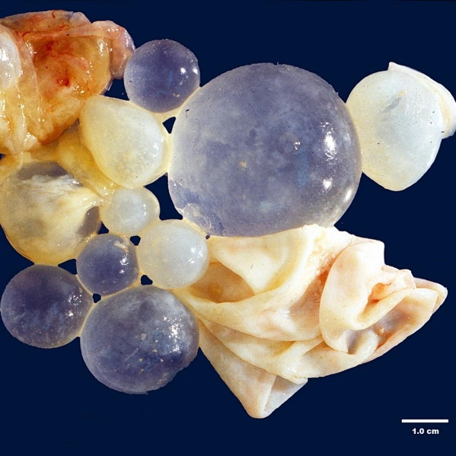

Slide 12
Composition of hydatid fluid
Clear colourless fluid (may be pale yellow in colour).
(ii) Specific gravity low, 1.005 to 1.010.
(iii) Reaction slightly acid, pH 6.7.
(iv) Contains sodium chloride, sodium sulphate, sodium phosphate and sodium and calcium salts of succinic acid _
(V) Antigenic, being used for immunological tests.
(vi) Highly toxic, when absorbed gives rise to anaphylactic symptoms.
(vii) Hydatid sand A granular deposit found to settle at the bottom.
It consists of liberated brood capsules free scolices and loose hooklets.

Slide 13
Development of brood capsule and scolices
Brood capsule sprout form germinal layer
5-20 scolices develops in these capsules
Rate of growth: by 1 year it is 4 cm in diameter
Distribution of the cyst: first the liver and any other organ can be involved

Slide 14
Lab diagnosis
Casoni’s reaction
It Immediate hypersensitivity skin test to diagnose hyadatid cyst
Intradermal injection 0.2 ml of sterile hydatid fluid is injected with in 30 minutes produce a large wheal ( 5cm In diameter) it fades in 1 hour.

Slide 15
Molecular methods such as DNA probe and PCR have been developer value because of their technical complexity.
4. Exploratory Cyst Puncture. Though an accurate diagnosis may be made by withdrawing a few millilitres of the hydatid fluid and examining it under the microscope for scolices or hooklets, yet it is often attended with serious results and is therefore not advised.

Slide 16
5. Radiological. This is often helpful in the diagnosis of hydatid cysts of lungs and liver. Shows a characteristic circular shadow with a sharp outline
In cases where the long bones are involved a mottled appearance is seen in the skiagram.
Ultrasonography of whole abdomen is useful in locating the site of hydatid cyst of the abdominal organs.
CT scan is more helpful than MRI scan in the diagnosis of diseases of different organs.

Slide 17
CLASS TREMATODA
Leaf shaped unsegmented worms called flukes
Posses 2 suckers oral sucker and a ventral sucker
Sexes are not separate
Body cavity is absent
They are oviparous and liberate eggs
Eggs are operculated and can develop only in water

Slide 18
Larval satges
Miracidium
Sporocyst
Redia
Cercaria
Metacercaria

Slide 19
Classification of trematodes according to habitat
Intestinal trematodes
Hepatic trematodes
Lung trematodes
Blood trematodes( blood fluke)

